Slide 1
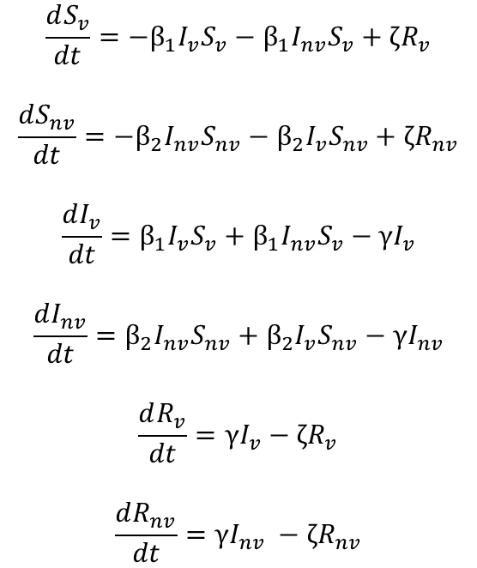
ζR_{v}
Model Equations
With ζ = 1/365
$$\frac{dS_{v}}{dt}=−β_{1}I_{v}S_{v}−β_{1}I_{nv}S_{v}+ζR_{v}$$
$$\frac{dS_{nv}}{dt}=−β_{2}I_{nv}S_{nv}−β_{2}I_{v}S_{nv}+ζR_{nv}$$
$$\frac{dI_{v}}{dt}=β_{1}I_{v}S_{v}+β_{1}I_{nv}S_{v}−γI_{v}$$
$$\frac{dI_{nv}}{dt}=β_{2}I_{nv}S_{nv}+β_{2}I_{v}S_{nv}−γI_{nv}$$
$$\frac{dR_{v}}{dt}=γI_{v}−ζR_{v}$$
$$\frac{dR_{nv}}{dt}=γI_{nv} −ζR_{nv}$$
Vulnerable
Population
S_{v}
β₁I_{v}S_{v}
I_{v}
γI_{v}
R_{v}
β₁I_{nv}S_{v}
β₂I_{v}S_{nv}
Non-Vulnerable
Population
S_{nv}
I_{nv}
R_{nv}
β₂I_{nv}S_{nv}
γI_{nv}
ζR_{nv}
Phase | Weeks | Beta1 | Beta2
0 | Up to I(t) = 0.0182 | 0.161 | 0.161
1 | 0-6 | 0.064 | 0.064
2 | 6-30 | 0.064/0.032/0 | 0.161
3 | 30 onwards | 0.161 | 0.161
4 | If phase 3 ends | 0.258 | 0.258
Phase | Weeks | Beta1 | Beta2
0 | Up to I(t) = 0.0182 | 0.161 | 0.161
1 | 0-6 | 0.097 | 0.097
2 | 6-30 | 0.097/0.049/0 | 0.161
3 | 30 onwards | 0.161 | 0.161
4 | If phase 3 ends | 0.258 | 0.258
BASELINE
RWC
Initial Conditions
Sv | Snv | Iv | Inv | Rv | Rnv
0.2 | 0.7999 | 0 | 0.0001 | 0 | 0
Equivalent to R0 = 2.4 -> 1.5 -> 0.6/0.3/0 -> 2.4

Slide 2
SIRS Model
Implement the RWC scenario and the alternative beta1 (0.064, 0.032 and 0) parameters for the SIRS model – identify the resulting trajectory plots
Vary the timeline to see if it reaches equilibrium

Slide 3
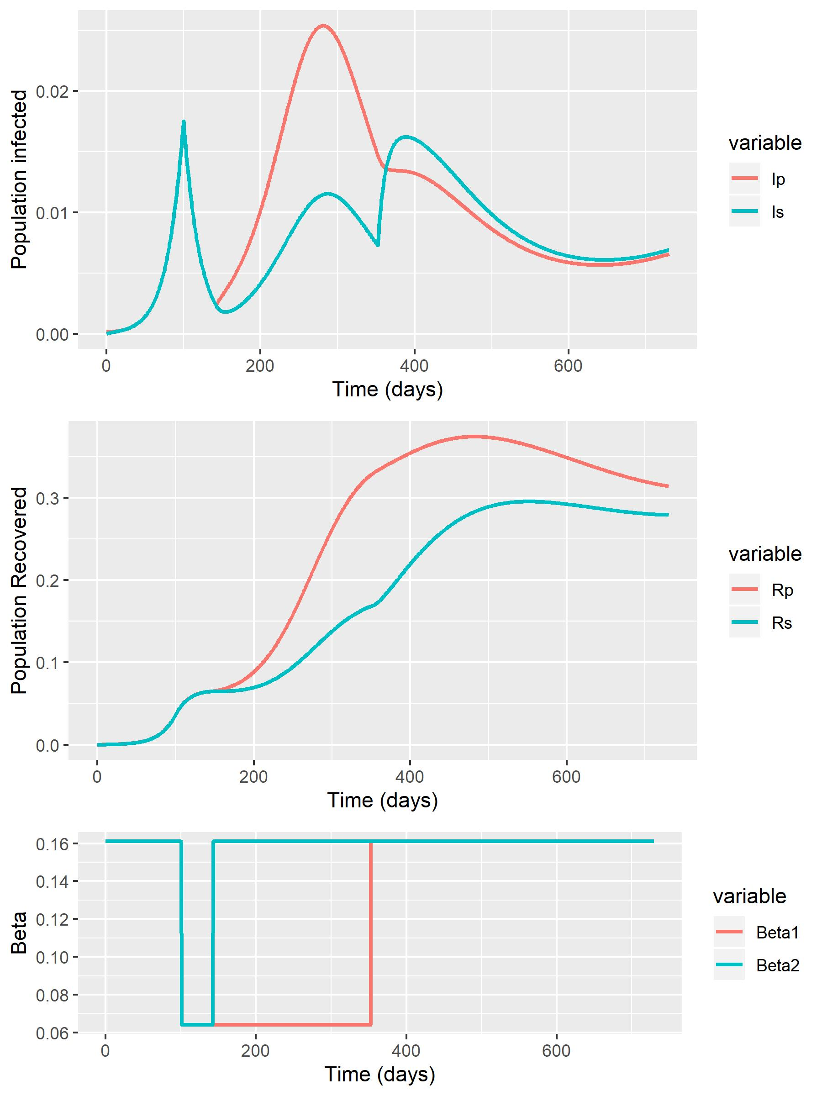
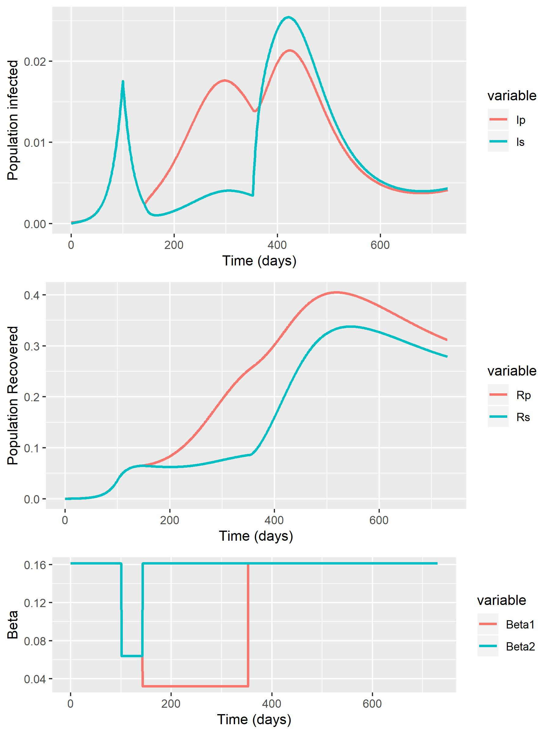
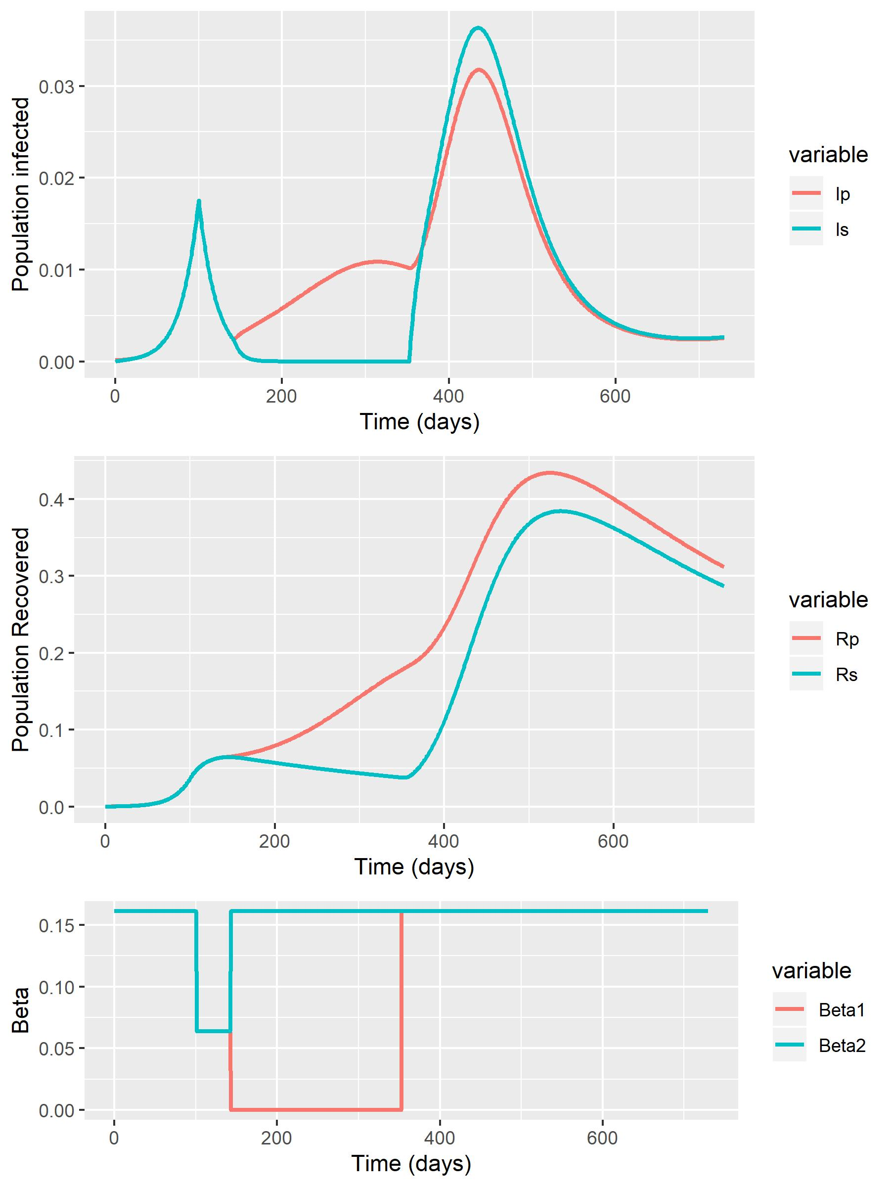
Baseline
Phase 2 (Beta1 = 0.064)
Phase 2 (Beta1 = 0.032)
Phase 2 (Beta1 = 0)

Slide 4
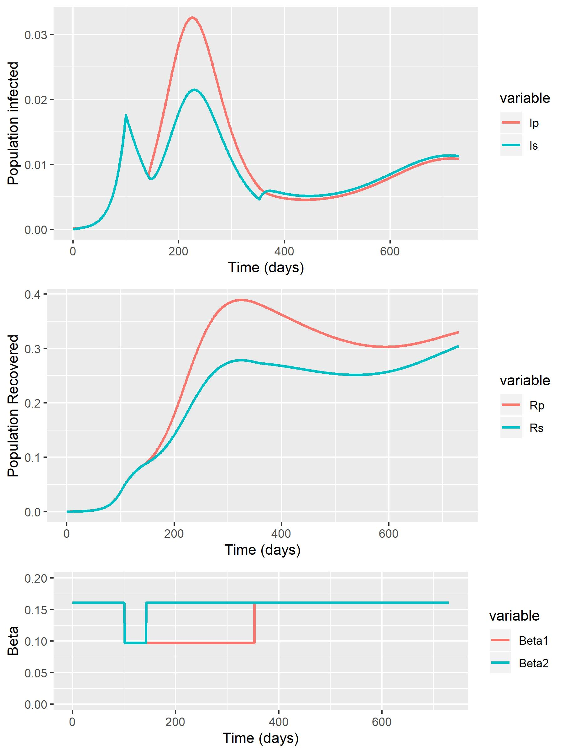
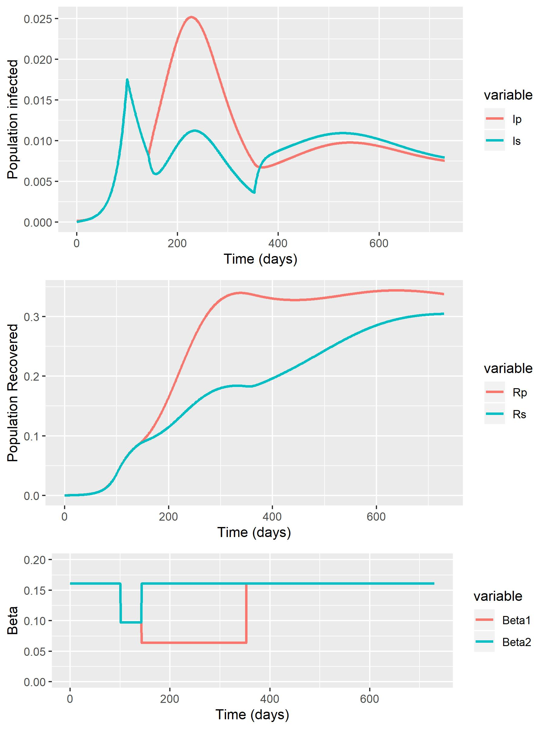
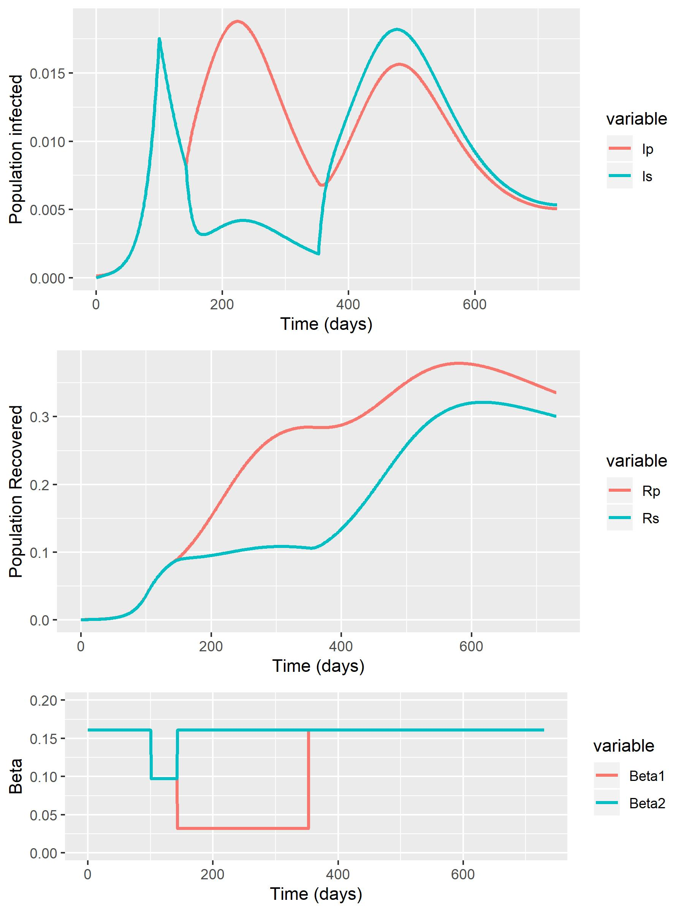
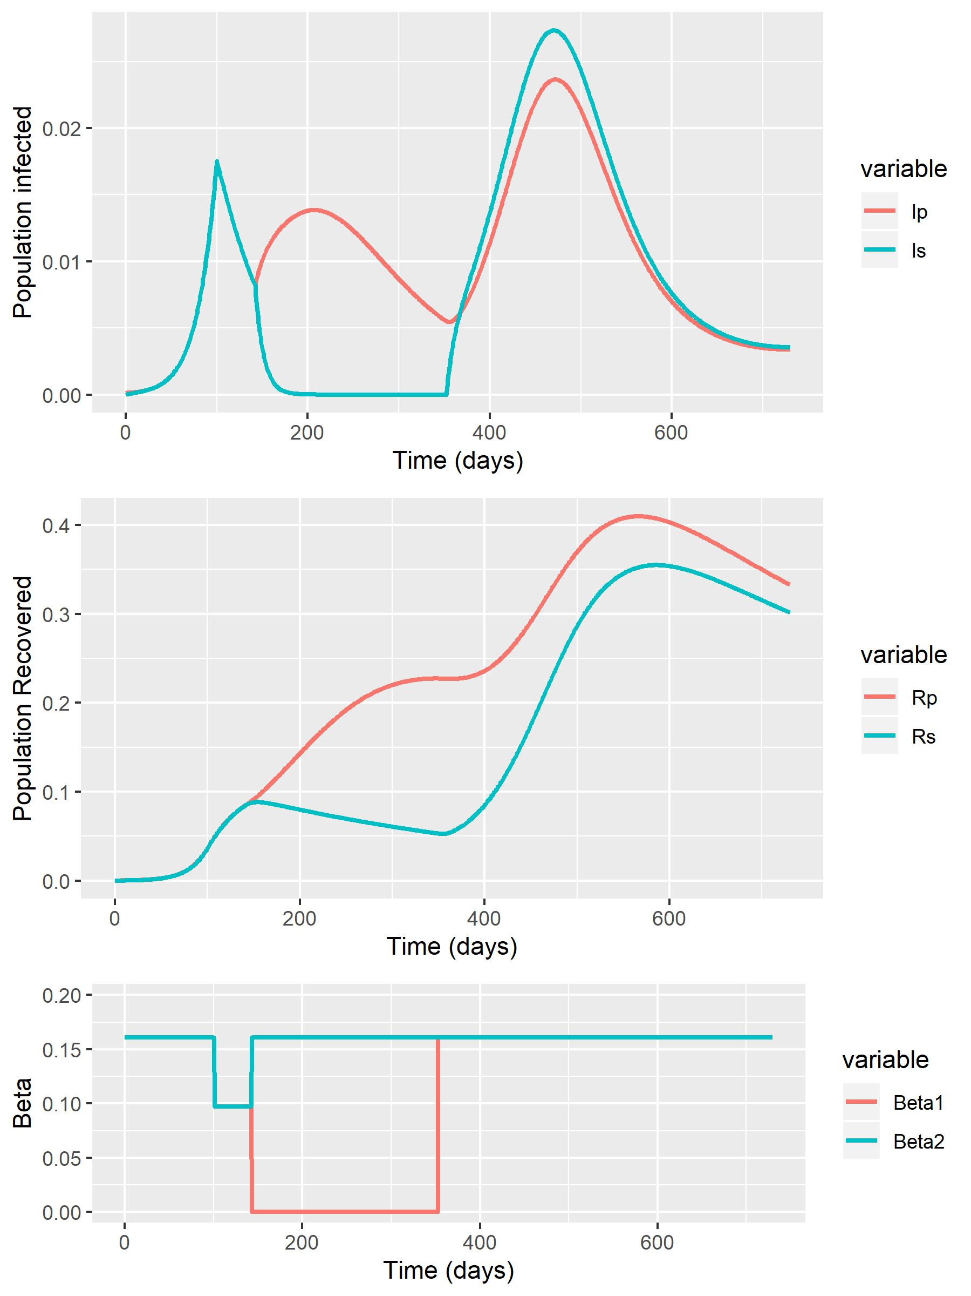
RWC + Baseline (0.064) – 2 Years (Base Timescale)
Phase 2 (Beta1 = 0.097)
Phase 2 (Beta1 = 0.064)
Phase 2 (Beta1 = 0.032)
Phase 2 (Beta1 = 0)

Slide 5
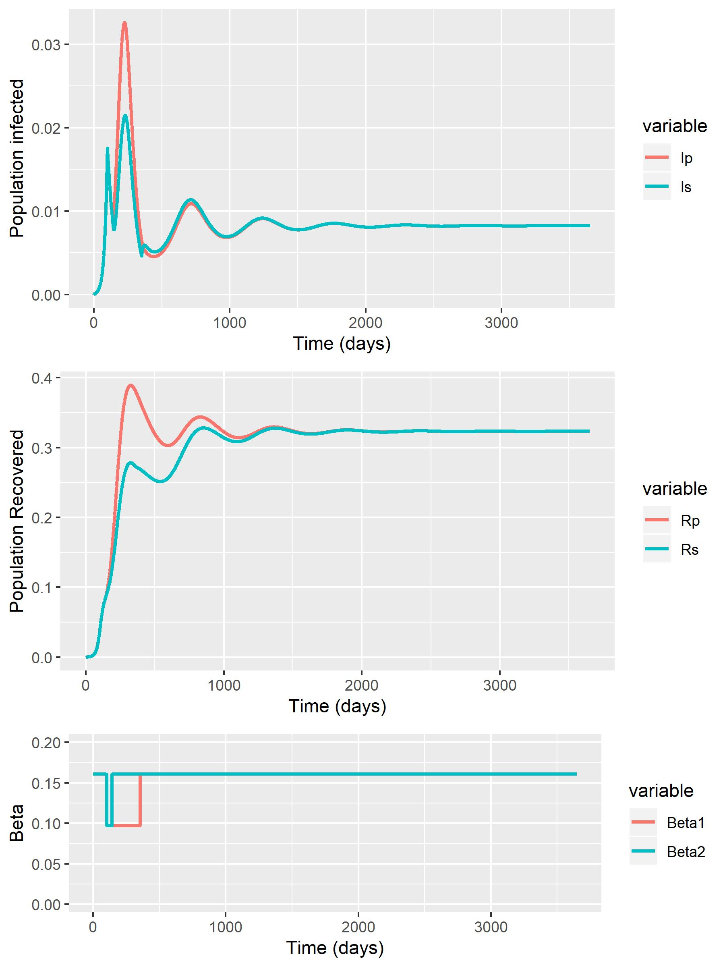
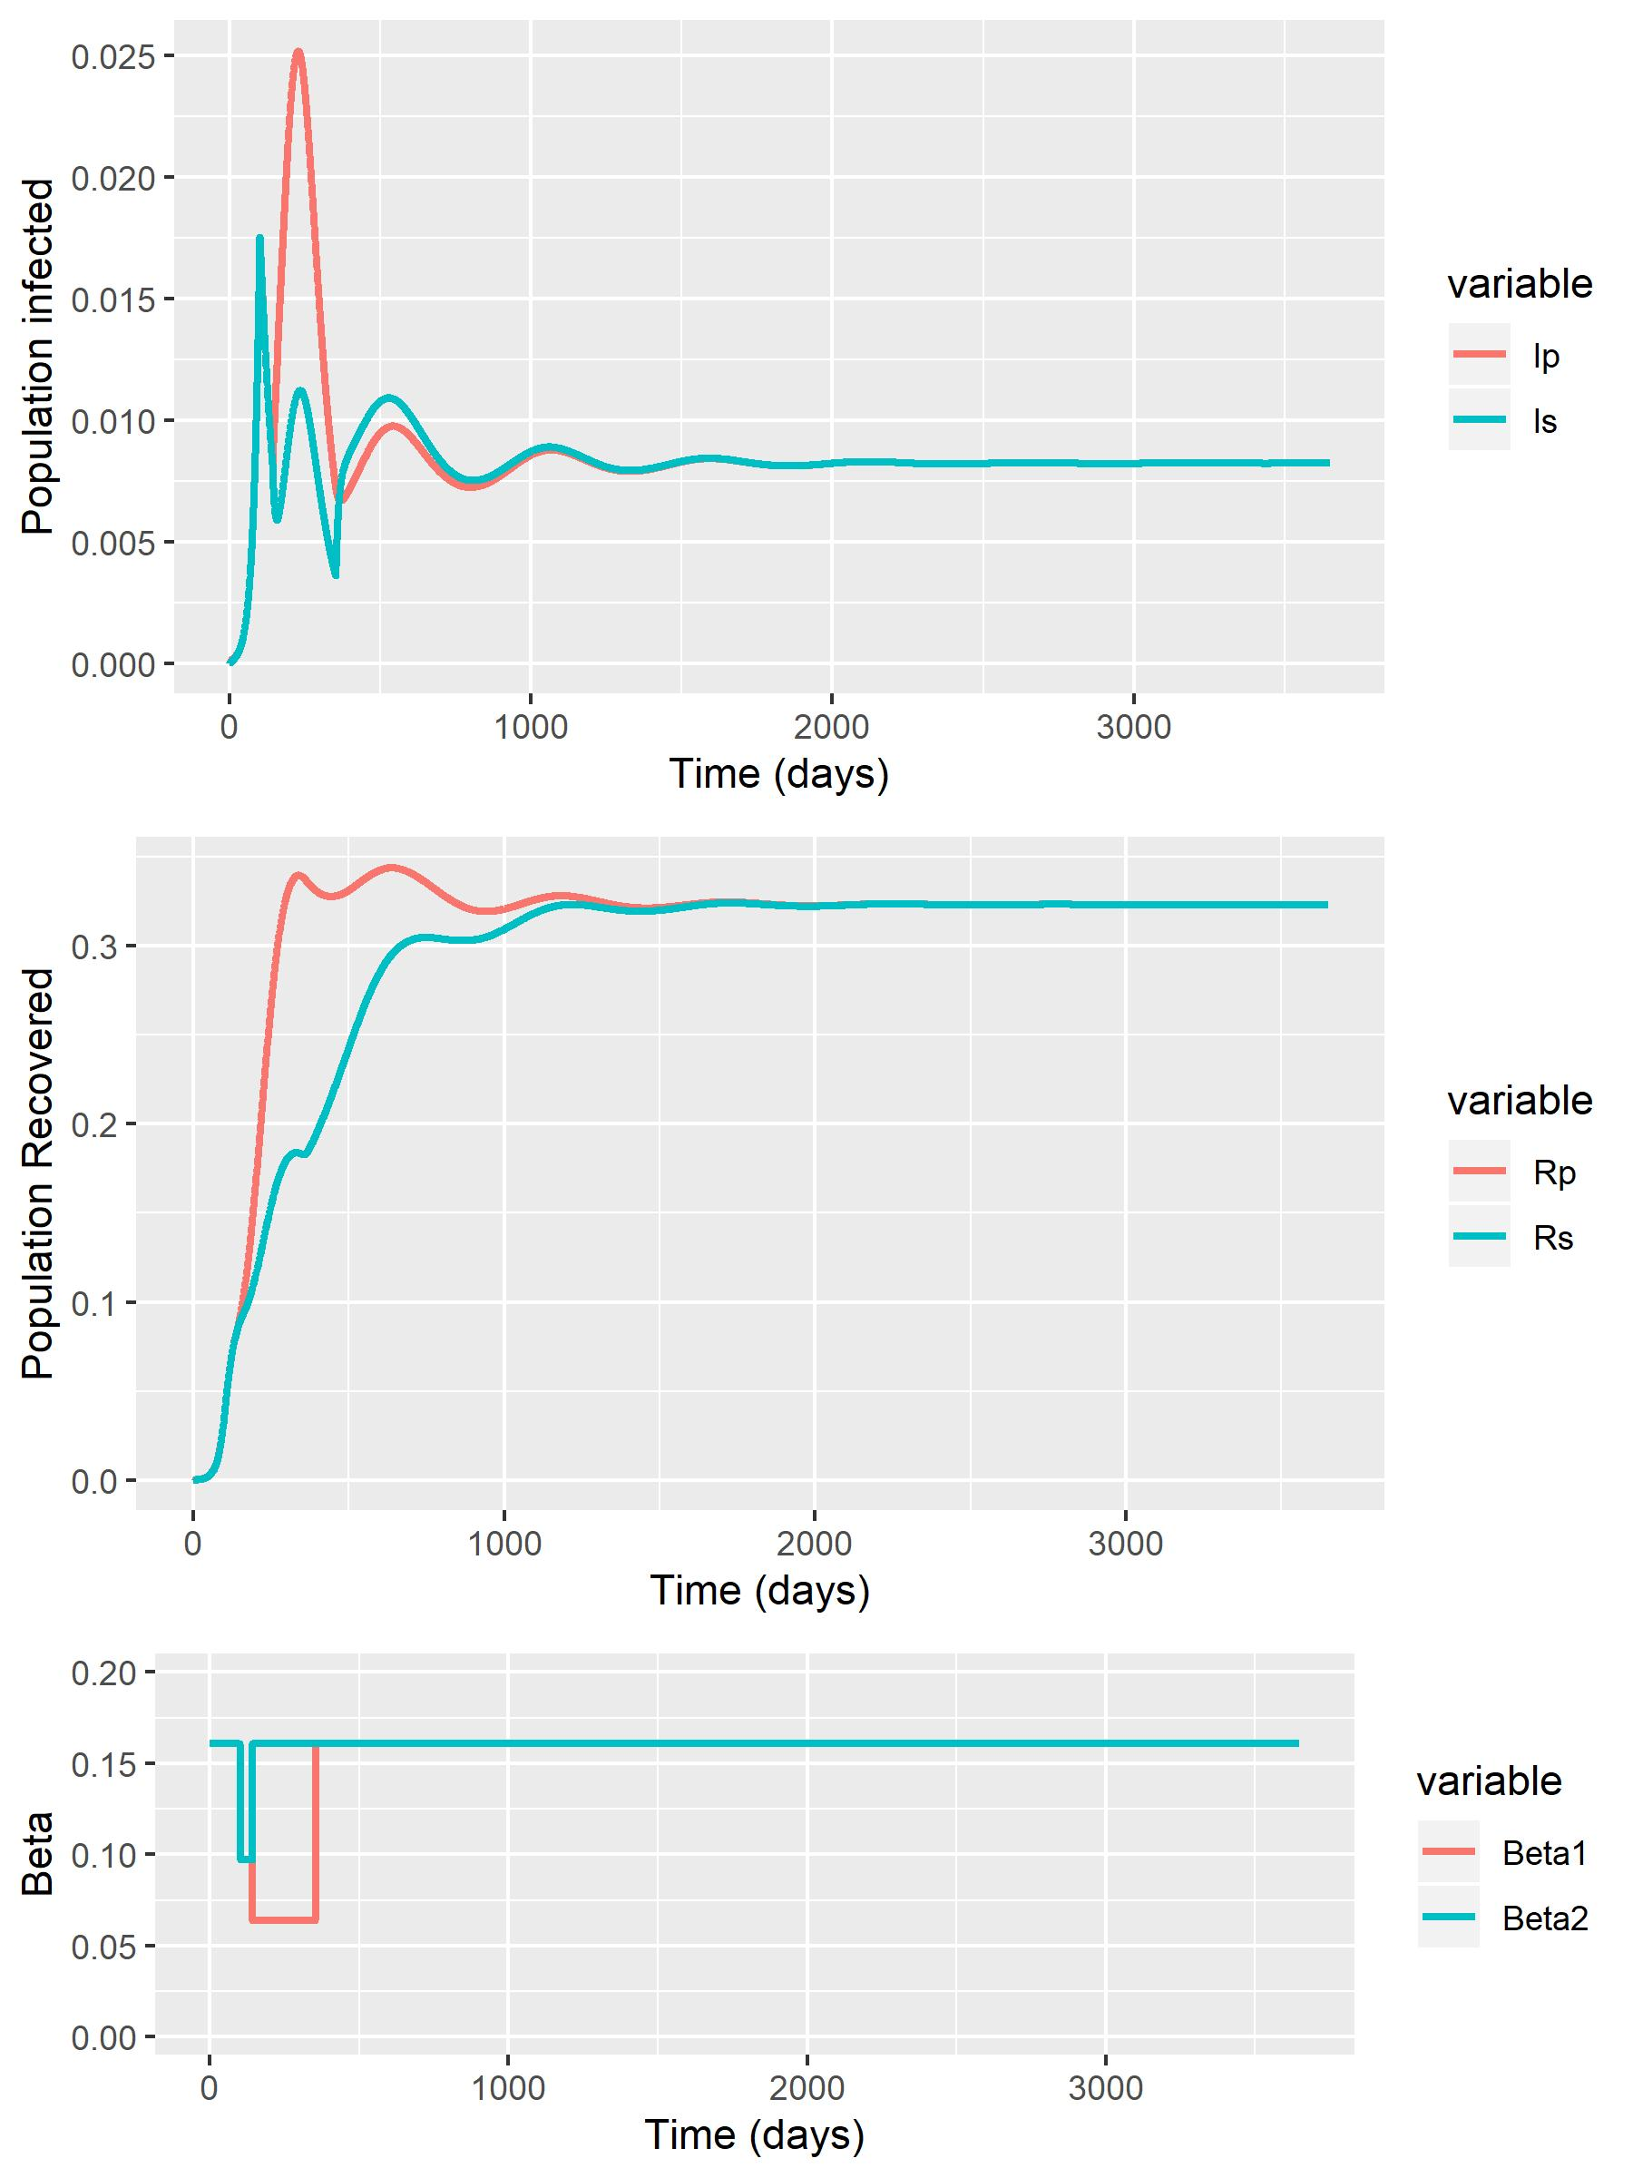
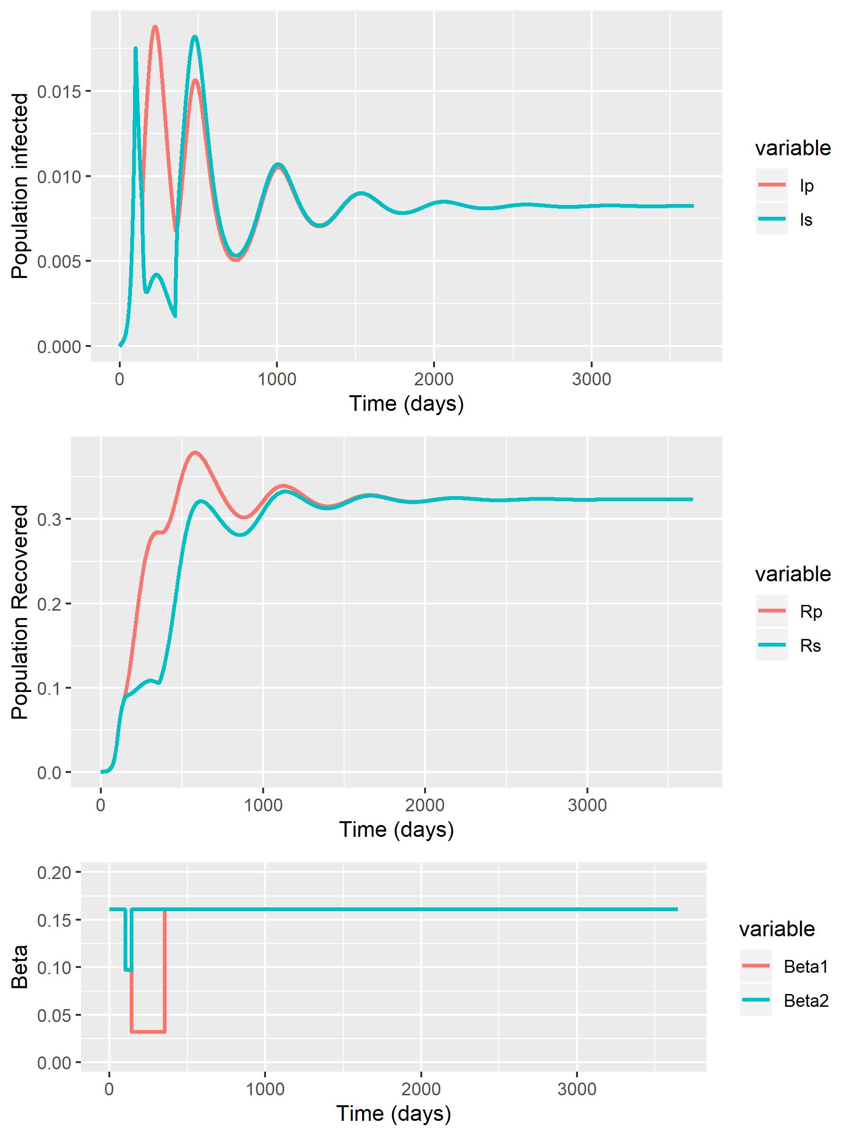
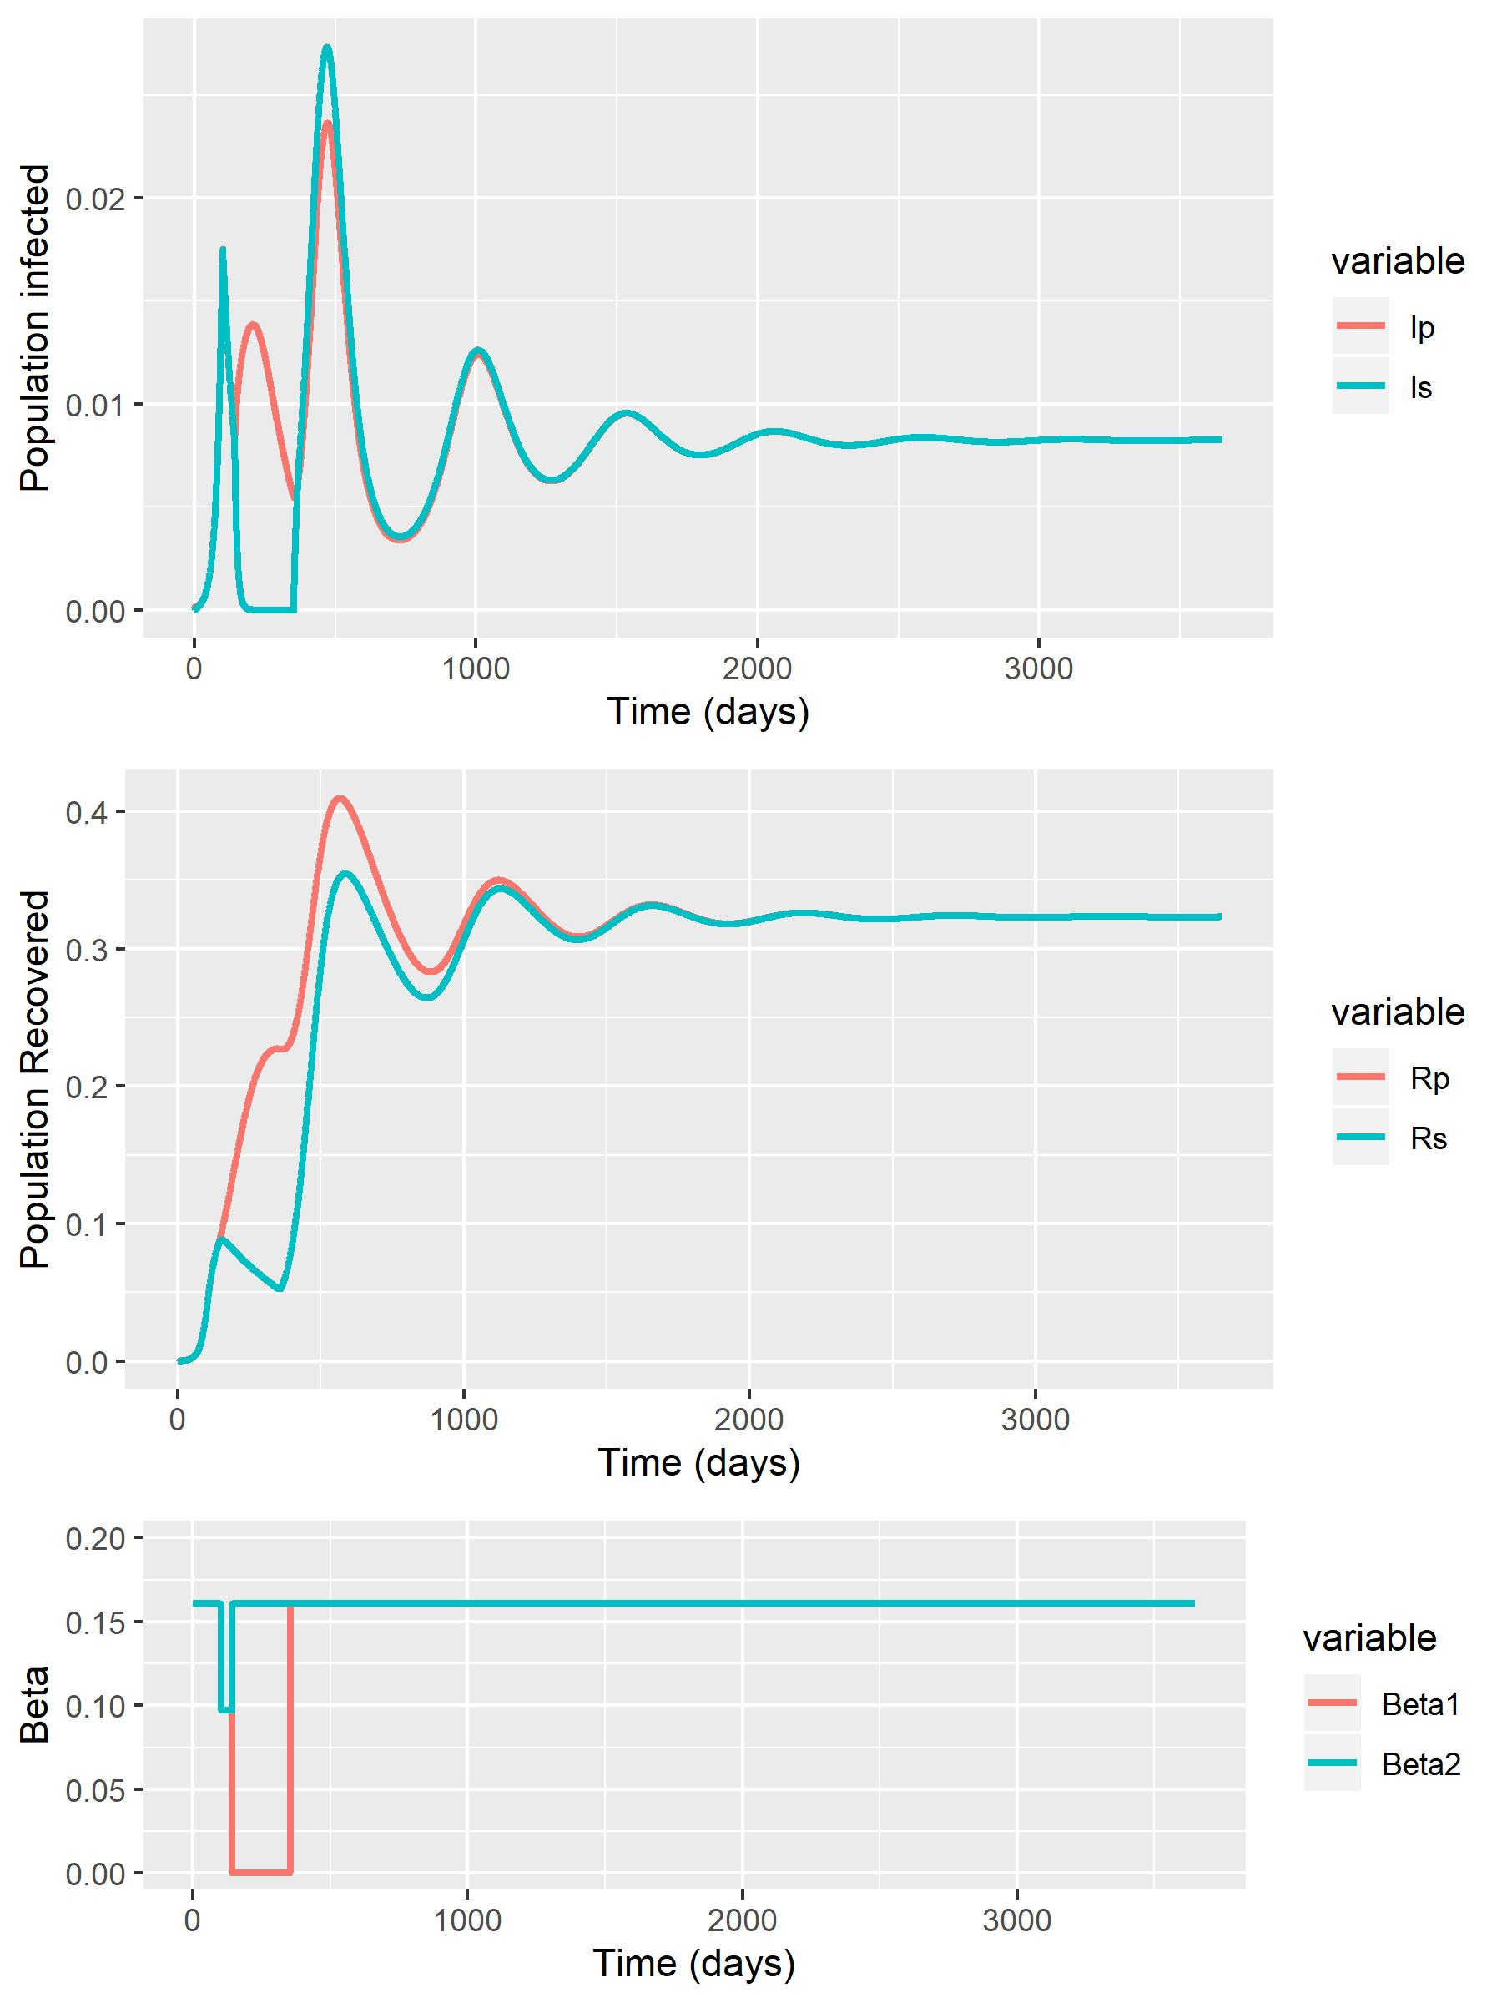
RWC + Baseline (0.064) – 10 Years (Timescale to observe Equilbrium)
Phase 2 (Beta1 = 0.097)
Phase 2 (Beta1 = 0.064)
Phase 2 (Beta1 = 0.032)
Phase 2 (Beta1 = 0)

